Slide 1
Digital Citizenship
What your responsibilities are

Slide 2

Video
Digital Citizenship Video (About 5 minutes)
https://www.youtube.com/watch?v=h0qKYItuees

Slide 3

Elements

Slide 4

Etiquette
Use technology at appropriate times and always ask for permission in unsure if use is appropriate.
Follow the rules and policies established at OHVA in the digital citizenship policy and use handbook

Slide 5

Communication
Include everyone in conversations, use digital communication productively and appropriately
Check your email regularly and reply to your teachers. Always re-read your responses before sending.
Avoid Cyber bullying. OHVA does not tolerate this.
Spamming chat is not appropriate.
Avoid private messaging classmates during. Your teachers can see all your chat messages.

Slide 6

Learning (Education)
Learn how to use your technology for your education
Become digitally literate
Help others learn how to use technology
Retrieve, store and share information responsibly. (you must get permission from teachers and parents to share personal information.)
Create technology – infused projects

Slide 7

Access
Help ensure every one has equal access
Incorporate technology into your learning
Help bridge the possibility of the digital divide between peers
Advocate for your own access in your community
Work together on assignments when possible.

Slide 8

Commerce
Be responsible when buying and selling online.
Always ask parents for permission before purchasing anything online
Be aware of the possibility of identity theft online.

Slide 9

Responsibility
Be accountable for your online actions
Proper citing of information and adhering to school plagiarism policy and checking validity of sources
Follow the school code of conduct for online behavior as found in the OHVA handbook.

Slide 10

Your Rights
Know how to use school technology appropriately
Do you know your rights and responsibilities? Read the OHVA Handbook
There is a difference in the rights inside and outside of school.
Be respectful of the rights of others and their online contributions.
Students have the same copyright creators. (Ribble et al., 2004, page 9)

Slide 11

Safety
Be aware of the physical dangers that are inherent in using technology
Understand your long term effects of technology use.
Limit time spent using technologies
Use good lighting and proper furniture.

Slide 12

Security
Keep your personal information private
Report any questionable online behaviors
Protect and back up your electronic data
Protect your identity while online
Follow all OHVA school protocols.
If unsure, ASK an adult.

Slide 13
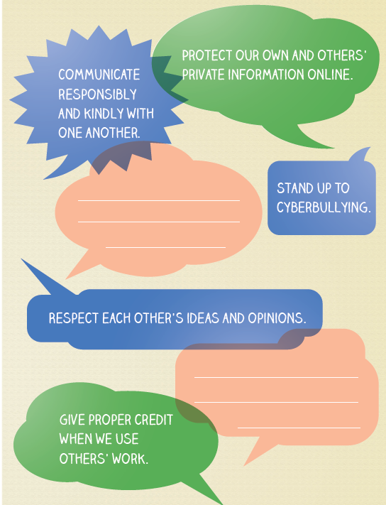
Pledge to be good Digital Citizens

